Slide 1



GROCERY MANAGEMENT SYSTEM
KONGU ENGINEERING COLLEGE
COMPUTER SCIENCE AND DESIGN DEPARTMENT
BY:
MITHRA 23CDR091
NIVETHAA V S 23CDR115
POOJA R 23CDR119

Slide 2
Problem Description
A local grocery store wants to digitize its inventory and sales process to improve efficiency and reduce human errors. Currently, all operations are done manually, which leads to issues such as inaccurate stock levels, expired products being sold, and slow billing. The goal is to design and implement a Grocery Management System that can handle the task.

Slide 3
Objectives
Inventory Management
Sales and Billing
User Roles.
Reports
System Requirements
3

Slide 4
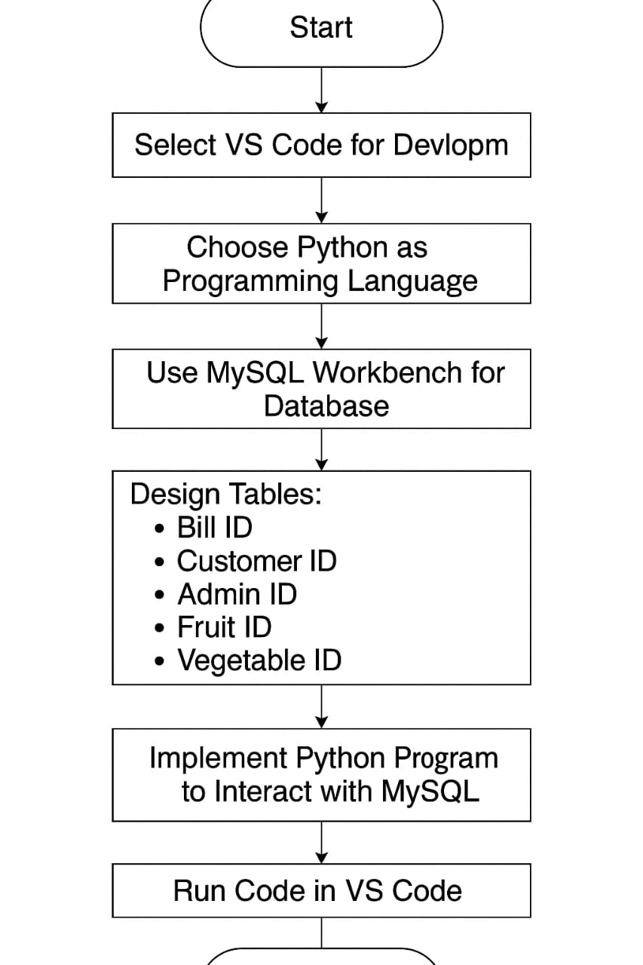
Flow Chart
4

Slide 5
HOW THE FLOWCHART WORKS :
This flowchart outlines the process of developing a Grocery Management System using Python, MySQL, and VS Code. The development begins by selecting Visual Studio Code (VS Code) as the primary development environment due to its flexibility and rich support for Python programming. Next, Python is chosen as the programming language for implementing the logic of the application, mainly because of its simplicity and wide availability of libraries for database interaction. To manage the data, MySQL Workbench is used to design and maintain the database structure.

Slide 6
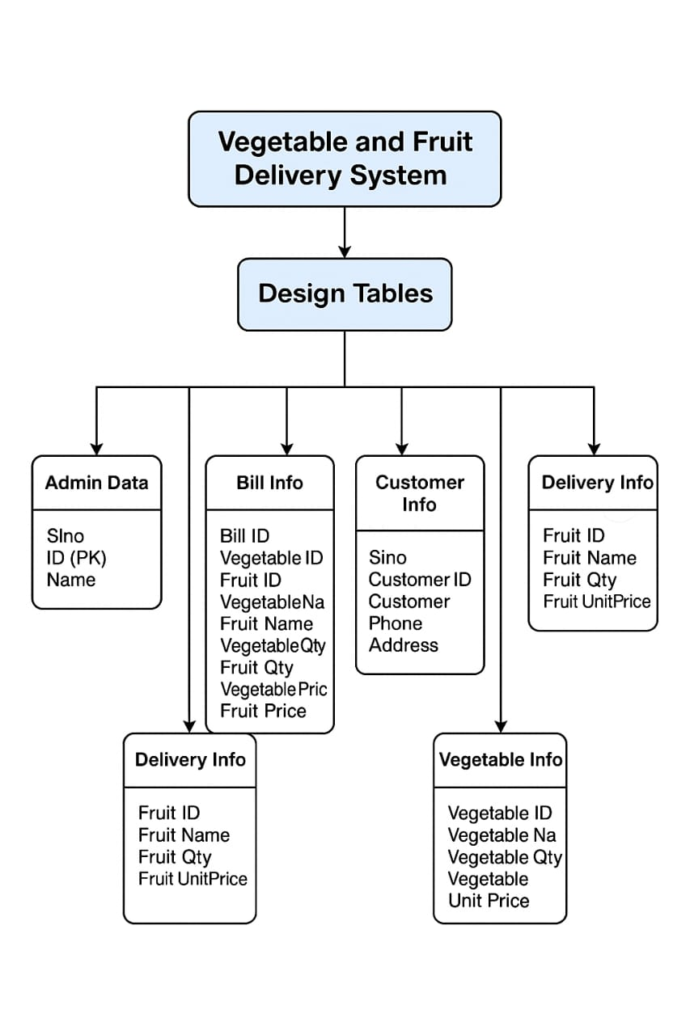

Slide 7
HOW THE FLOWCHART WORKS:
The flowchart outlines the database design for a Vegetable and Fruit Delivery System using multiple interconnected tables. The Admin Data table holds admin details, while Customer Info stores customer names, contact numbers, and addresses. Vegetable Info and Delivery Info manage stock details like item names, quantities, and prices. When a customer places an order, the Bill Info table pulls relevant data from the customer and item tables to generate a detailed bill, including item names, quantities, and prices. This design helps track orders, manage inventory, and streamline billing, ensuring efficient operation of the delivery service.

Slide 8
TOOLS AND TECHNOLOGIES USED
VS Code – Used as the Integrated Development Environment.
Python – Main programming language for the application logic
MySQL Workbench – Database used to store and manage data.
Libraries:
pymysql – to connect Python to MySQL
os, datetime – for extra utility functions

Slide 9
Thank you!

